Slide 1

Mini Project Work-Phase 1 Review/21MP210
Project Review Presentation (50 Mks) – SEE SEPTEMBER 2022, First Year (2nd Semester)
Dayananda Sagar College of Engineering, Bangalore, Karnataka
Department of Electronics & Communication Engineering
Section : N
Developing ELECTRO-SPOT Website using VS-CODE Software
Mini Project Batch No : N-20
USN : 1DS21EC201 (Sec-N) Name : SHUBHANSHU JAIN
USN : 1DS21EC187 (Sec-N) Name : SAURABH KUMAR
USN : 1DS21EC225 (Sec-N) Name : VAIDIK SINGH NIRWAN
USN : 1DS21EC041 (Sec-N) Name : AYUSH GUPTA
Section Coordinator
Prof. NAVYA HOLLA K.
Mini Project Guide
Prof. KAVITA GUDDAD

Slide 2
Overview of the mini project SEE presentation
Introduction
Literature Survey
Scope ,problem statement and Objectives
Methodology adopted with Block-Diagrams & Flow-Charts
H/w & S/w tools used
Implementation procedures carried out (h/w - s/w)
Results (experimentation or simulation)
Photographs of the hardware developed (if)
Advantages / Applications
Conclusions
Outcome of the project work
Flow of the works (May’22 – Sep’22)
References used

Slide 3
Introduction to the mini-project (abstract) - highlights
As we know that today’s generation is living in digital world and sometimes this digital world serves us lots of misleading and fake information with us.
So, our group has decided to host a website named “ELECTROSPOT” which contains reliable and knowledgeable content which will be very useful for college student in their projects and assignment. This website contains information gathered from trustworthy sources like books, articles, newsletters, scientist’s work and electronics experiments. This project mainly consist of developing a website that contains various information, uses , studies , research , block-diagram , circuit-diagram of various types of electronics components like resistors , capacitors , 555 Ic-timer , Oscillators , MOSFETS , Op-Amps , etc. Users on our website can access to various information on electronics and no need to install any application on pc or mobileUseful for study of different electronics components along with full description of them. Website can further be updated regularly with new information and experiments. If you are a skilled web development professional, you will have several career options available in front of you. You may have to add a skill or two to your repertoire, but we don’t think that’s asking too much for a good career. Here are a few career options, to develop a website that accommodate different electronics component information along with its circuit diagrams, flow charts, etc., website named ELECTROSPOT “ to be hosted on internet. The aim of the project is to create a electronics website named as ELECTROSPOT which will be useful for studying various electronics components at one place. Aesthetic user interface, making it an enriching experience for creation of web pages.

Slide 4
Scope ,Problem Statement & Definition
Scope- useful for study of different electronics components along with full description of them. website can further be updated regularly with new information and experiments. If you are a skilled web development professional, you will have several career options available in front of you. You may have to add a skill or two to your repertoire, but we don’t think that’s asking too much for a good career. Here are a few career options.
Problem statement- to develop a website that accommodate different electronics component information along with its circuit diagrams, flow charts, etc.
Definition - website named ELECTROSPOT “ to be hosted on internet. The aim of the project is to create a electronics website named as ELECTROSPOT which will be useful for studying various electronics components at one place.
Aesthetic user interface, making it an enriching experience for user.

Slide 5
At
the end of this module,
you
will
be able
to
:
→
Importance
of
Web
Development
→
Web
Designer
Vs.
Web
Developer
→
Front
-
end and
Back
-
end Web
Development
→
HTML, CSS and
JavaScript
-
An
Overview
→
JavaScript
Frameworks
-
jQuery
and
React.
JS
→
Advanced
Web
Development
Topics
Objectives of the mini-project work
The main objective of the project is to develop the website and study various components of electronics and incorporate in our website which is helpful for any new student or 1st year student who is new to the world of electronics
Learning web development
Hosting a website on internet
Knowledge of different electronics components
Front-end and back-end development
Working on Atom Software
HTML,CSS and JAVASCRIPT
Mongo-DB software

Slide 6
Methodology adopted with block-diagrams & flow-charts
Web development refers to the building, creating, and maintaining of websites. It includes aspects such as web design, web publishing, web programming, and database management. It is the creation of an application that works over the internet i.e. websites.
The word Web Development is made up of two words, that is:
Web: It refers to websites, web pages or anything that works over the internet.
Development: Building the application from scratch.
Web Development can be classified into two ways:
Frontend Development
Backend Development
First we will develop the front-part of website which mainly comprises of different sections of website like search bar, tool bar, circuit-diagrams ,etc. Then ,we will design back-part of website like adding data and information of different components and with their respective working principles and algorithms

Slide 7
Frontend Development: The part of a website that the user interacts directly is termed as front end. It is also referred to as the ‘client side’ of the application.
HTML: HTML stands for Hyper-Text Markup Language. It is used to design the front end portion of web pages using markup language. It acts as a skeleton for a website since it is used to make the structure of a website.
CSS: Cascading Style Sheets fondly referred to as CSS is a simply designed language intended to simplify the process of making web pages presentable. It is used to style our website.
JavaScript: JavaScript is a scripting language used to provide a dynamic behavior to our website.
Bootstrap: Bootstrap is a free and open-source tool collection for creating responsive websites and web applications. It is the most popular CSS framework for developing responsive, mobile-first websites. Nowadays, the websites are perfect for all the browsers (IE, Firefox, and Chrome) and for all sizes of screens (Desktop, Tablets and Phones).
Bootstrap 4
Bootstrap 5
Frontend Frameworks and Libraries:
AngularJS
React.js
VueJS
jQuery
Bootstrap
Material UI
Tailwind CSS
jQuery UI
Some other libraries and frameworks are: Handlebar.js Backbone.js, Ember.js etc.

Slide 8
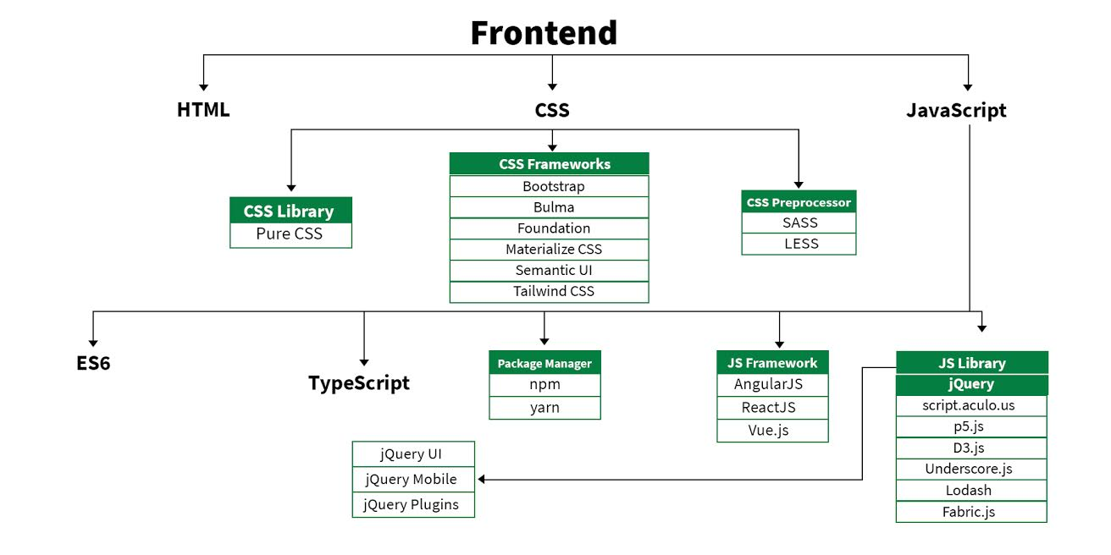

Slide 9
Backend Development: Backend is the server side of a website. It is the part of the website that users cannot see and interact. It is the portion of software that does not come in direct contact with the users. It is used to store and arrange data.
PHP: PHP is a server-side scripting language designed specifically for web development.
Java: Java is one of the most popular and widely used programming language. It is highly scalable.
Python: Python is a programming language that lets you work quickly and integrate systems more efficiently.
Node.js: Node.js is an open source and cross-platform runtime environment for executing JavaScript code outside a browser.
Back End Frameworks: The list of back end frameworks are: Express, Django, Rails, Laravel, Spring, etc.
Web Development Tutorials
HTML
CSS
JavaScript
jQuery
BootStrap
React JS
AngularJS
PHP
Node.js

Slide 10
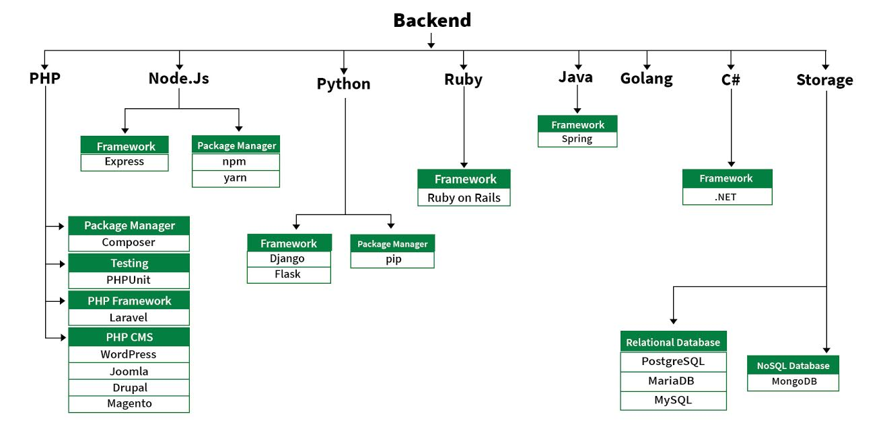

Slide 11
Hardware & Software tools used in the mini-project
The required components for the project are:
VS-CODE code editor /ATOM code editor
HTML
CSS
Java-Script
Mongo-DB
Node-JS
EJS
Mongoose

Slide 12
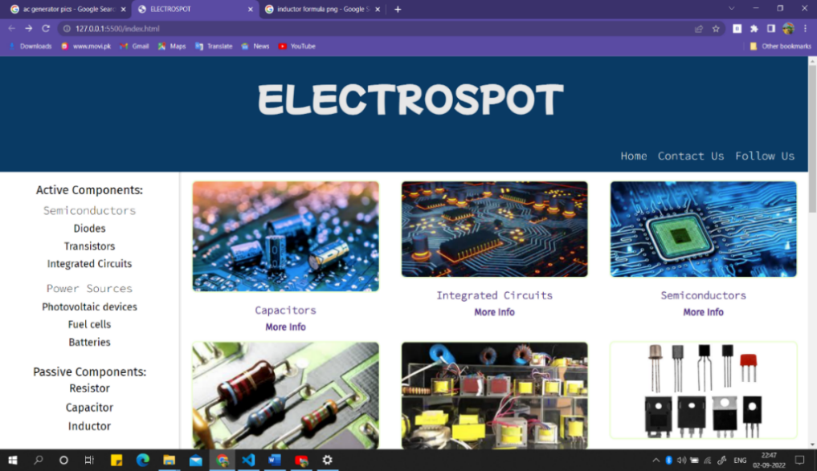
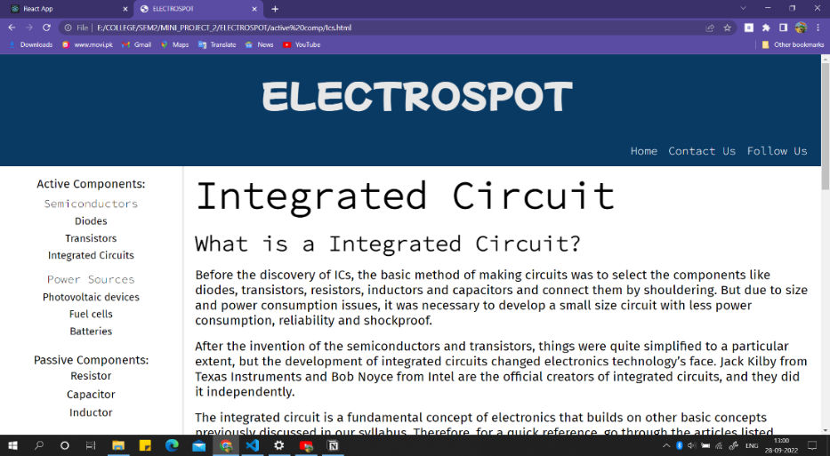
Results (experimentation or simulation)
This is our main page that appears as soon as we open the website. This is the frontend of our project and all the links and information are being stored in this website can be accessed with one click on the related topics which are being published on the website.
index.html

Slide 13
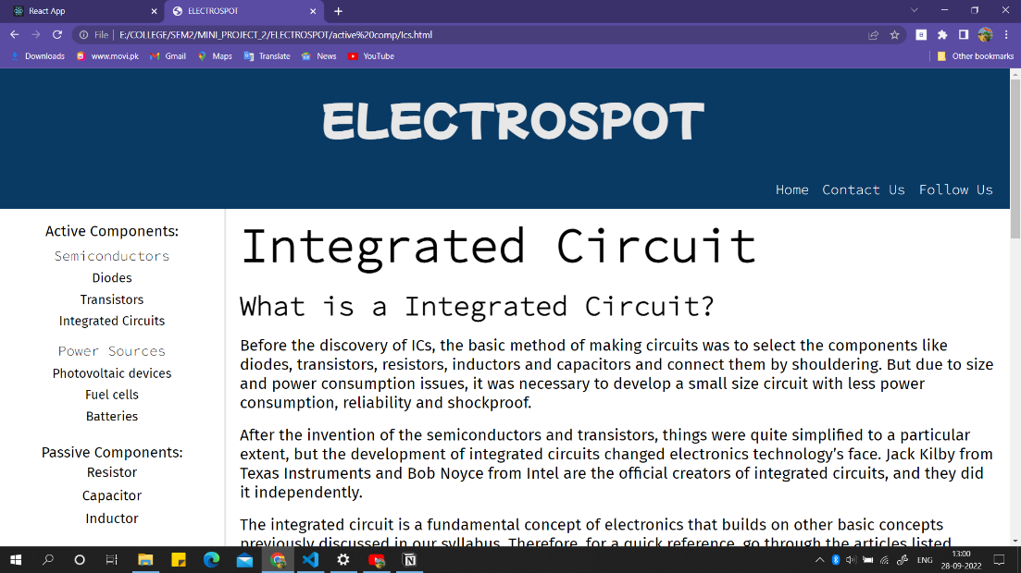
Steps to access our website:-
Open the website link
The frontend of the website will be shown
Select the topic you want to study about
Click on the topic
For Eg:- you want to study Integrated Circuit you can directly click on the IC link or else you can first navigate into the active components link and then to the IC link.

Slide 14
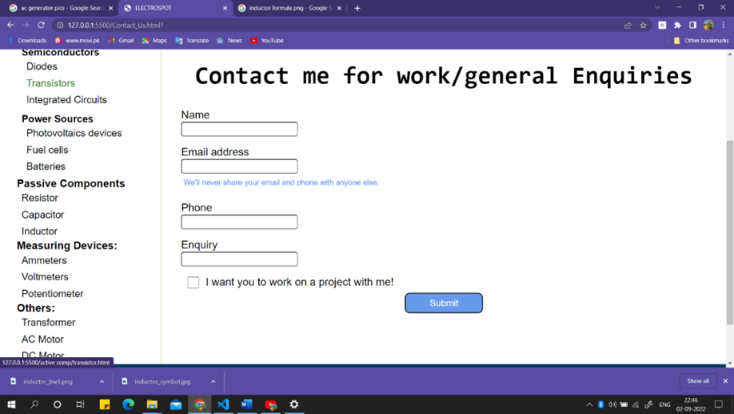
If anyone had had a query or they want to contact us or they had found any information misleading and want to remove or interrogate on it, they can reach us by using our contact me form function.

Slide 15
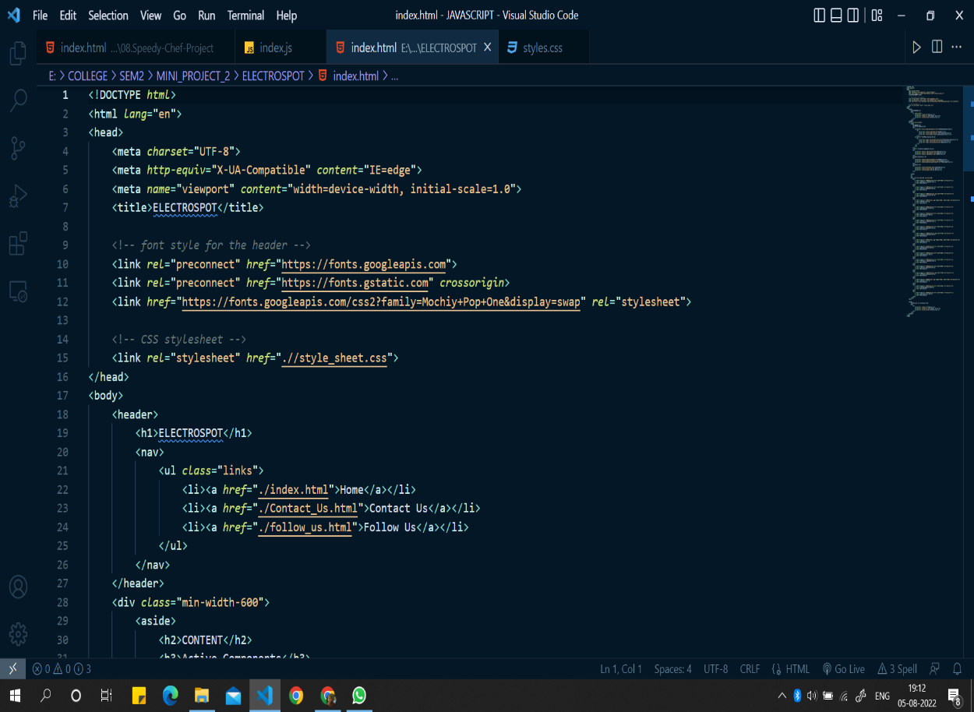
CODES
This code is of html component of our website. It acts as an skeleton of our website and after designing html part we can design and create other parts of our website

Slide 16
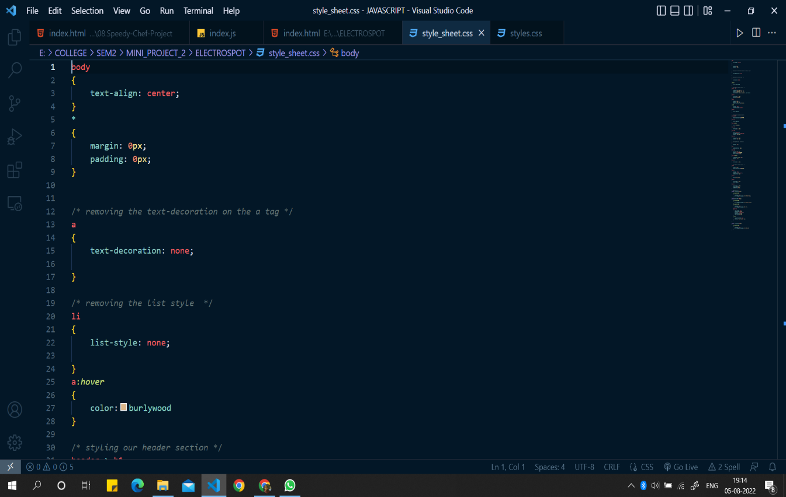
This is our CSS part of our website. It is basically used to design and decorate the website

Slide 17
Advantages / Applications
Anyone can use it for the study of various electronics components
At the bottom of our website a Google form is being provided for suggestions, error correction and other queries.
Website allows user to search any component individually from search bar
Any student coming from PUC can start their journey of electronics engineer
With the help of our website.
It can be used for study of various experiments and newsletters

Slide 18
Conclusions and future work of the mini-project work
Here, we conclude that we had successfully completed our front-end development part of our mini-project. we had studied frontend and applied it in our project wisely. Now, in coming future we are learning JAVASCRIPT and will apply it on our website to add various types of information in it. Full-flagged website which comprises of details of different electronics component.
The aim of the project is to create an electronics website named as ELECTROSPOT which will be useful for studying various electronics components at one place.
Aesthetic user interface, making it an enriching experience for creation of web pages
Through this project we will learn
How to design a website and host it to world wide web and also we will learn about different electronics web sites. This project has two parts front-end and back-end development of our website.
Front-end development consist up of languages like HTML and CSS. The main job of html and CSS are used for designing of our website and give it an aesthetic feel of a professional website. Then ,in back-end development languages like Java-script , mongoose, node JS is being used for defining and adding content to our website .Both front-end and back-end development gives us the final look of our website

Slide 19
Outcome of the mini-project work
Full-flagged website which comprises of details of different electronics component.
The aim of the project is to create a electronics website named as ELECTROSPOT which will be useful for studying various electronics components at one place.
Aesthetic user interface, making it an enriching experience for creation of web pages
Through this project we will learn
How to design a website and host it to world wide web and also we will learn about different electronics web sites. This project has two parts front-end and back-end development of our website.
Front-end development consist up of languages like HTML and CSS. The main job of html and css are used for designing of our website and give it an aesthetic feel of a professional website. Then,in back-end development languages like javascript, mongoose, node JS is being used for defining and adding content to our website .Both front-end and back-end development gives us the final look of our website.

Slide 20
Flow of the mini-project works (May’22 – Sep’22)
May-2022 | Case Study, topic search, finalization, approval from guide
Jun-2022 | Starting of the mini-project work, studying WEB DEVELOPMENT
Jul-2022 | front-end development(HTML and CSS)
Aug-2022 | back-end development (JAVASCRIPT, Mongo-DB ,Node-JS, E-JS, Mongoose)
Sep-2022 | Hosting it on internet, adding some useful tools in it, final demonstration followed by SEE

Slide 21
References Used
Web development course by UDEMY taught by Angela Yu
Basic Electronics by Chattopadhyay
J. S. Katre Electronics book
Basic Electronics by A. P. Godse

Slide 22


?
?
Questions

